Slide 1




Climate Change
TTCTTTCATGGGGAAGCAGATTTGGGTACCACCCAAGTATTGACTCACCCATCAACAACCGCTATGTATTTCGTACATTACTGCCAGCCACCATGAATATTGTACGGTACCATAAATACTTGACCACCTGTAGTACATAAAAACCCAATCCACATCAAAACCCCCTCCCCATGCTT3BTM ML19
Are you able to survive?

Slide 2
Introduction
TTCTTTCATGGGGAAGCAGATTTGGGTACCACCCAAGTATTGACTCACCCATCAACAACCGCTATGTATTTCGTACATTACTGCCAGCCACCATGAATATTGTACGGTACCATAAATACTTGACCACCTGTAGTACATAAAAACCCAATCCACATCAAAACCCCCTCCCCATGCTT3BTM ML19
It’s pleasantly warm outside. The average temperature is pretty nice, but there are some colder or warmer areas around, so the world is divided in four habitats.
The savannah is occupied by different species, perfectly adapted to their habitat. Life is easy.
But every now and then the climate changes. When the temperature increases the savannah expands; when it drops it shrinks and the ice grows. In order to survive, species need to adapt quickly and become new ones, or they will get extinct.
Do you have what is needed to survive? Which species will you be in 10 million years (=30 minutes)?

Slide 3
Contents (up to 5 players)
TTCTTTCATGGGGAAGCAGATTTGGGTACCACCCAAGTATTGACTCACCCATCAACAACCGCTATGTATTTCGTACATTACTGCCAGCCACCATGAATATTGTACGGTACCATAAATACTTGACCACCTGTAGTACATAAAAACCCAATCCACATCAAAACCCCCTCCCCATGCTT3BTM ML19
5 boards showing how the habitats are distributed with different temperature, numbered from 1 (coldest) to 5 (warmest).
5 species figurines
20 tokens (5 for each habitat)
51 mutation cards (5 “+1” and 5 “-1” for each gene, 10 neutral mutations, 1 deleterious mutation)
5 Genomes tables
15 Small stones to mark the adaptation on the genome board.
1 dice

Slide 4
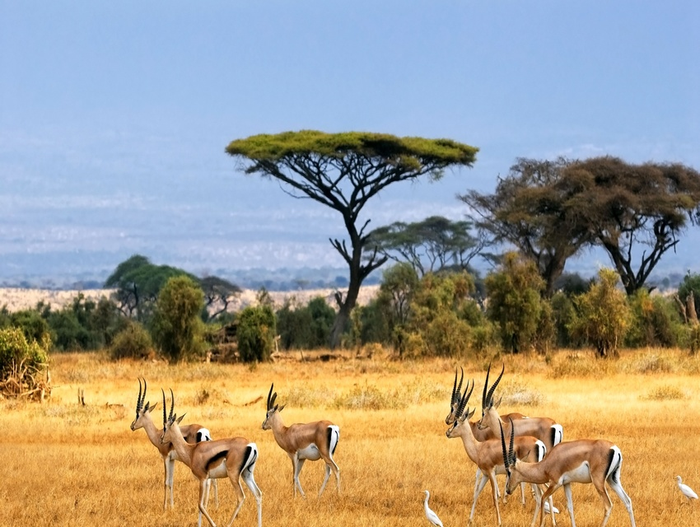
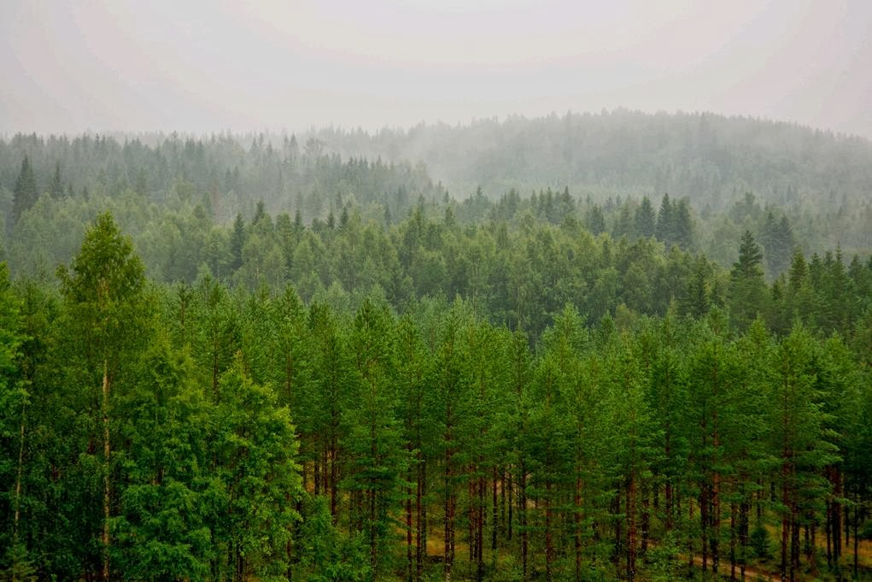
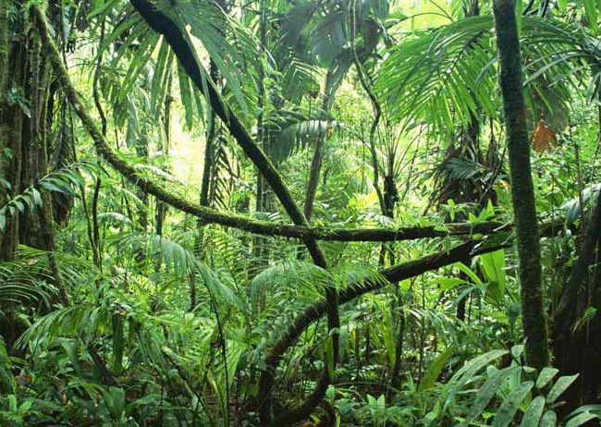
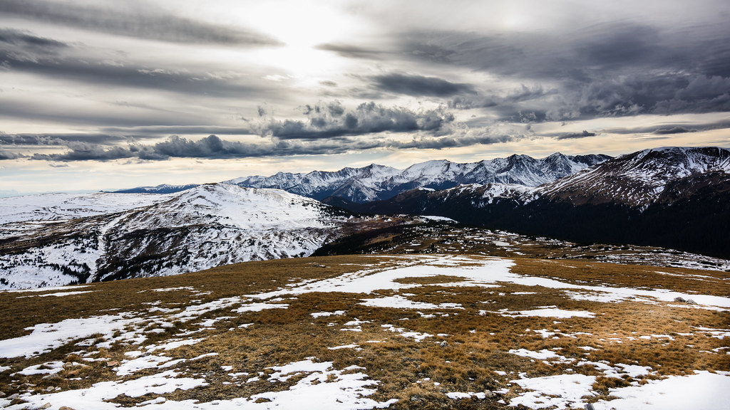
Board: Habitats
TTCTTTCATGGGGAAGCAGATTTGGGTACCACCCAAGTATTGACTCACCCATCAACAACCGCTATGTATTTCGTACATTACTGCCAGCCACCATGAATATTGTACGGTACCATAAATACTTGACCACCTGTAGTACATAAAAACCCAATCCACATCAAAACCCCCTCCCCATGCTT3BTM ML19
TEMP
TUN
TROP
SAV
There are 4 type of habitat:
Savannah: warm and seasonally humid, not many trees
Tropical forest: warm and humid, tropical trees
Temperate forest: cold and humid, temperate trees
Tundra: cold and dry, few vegetation, no trees

Slide 5
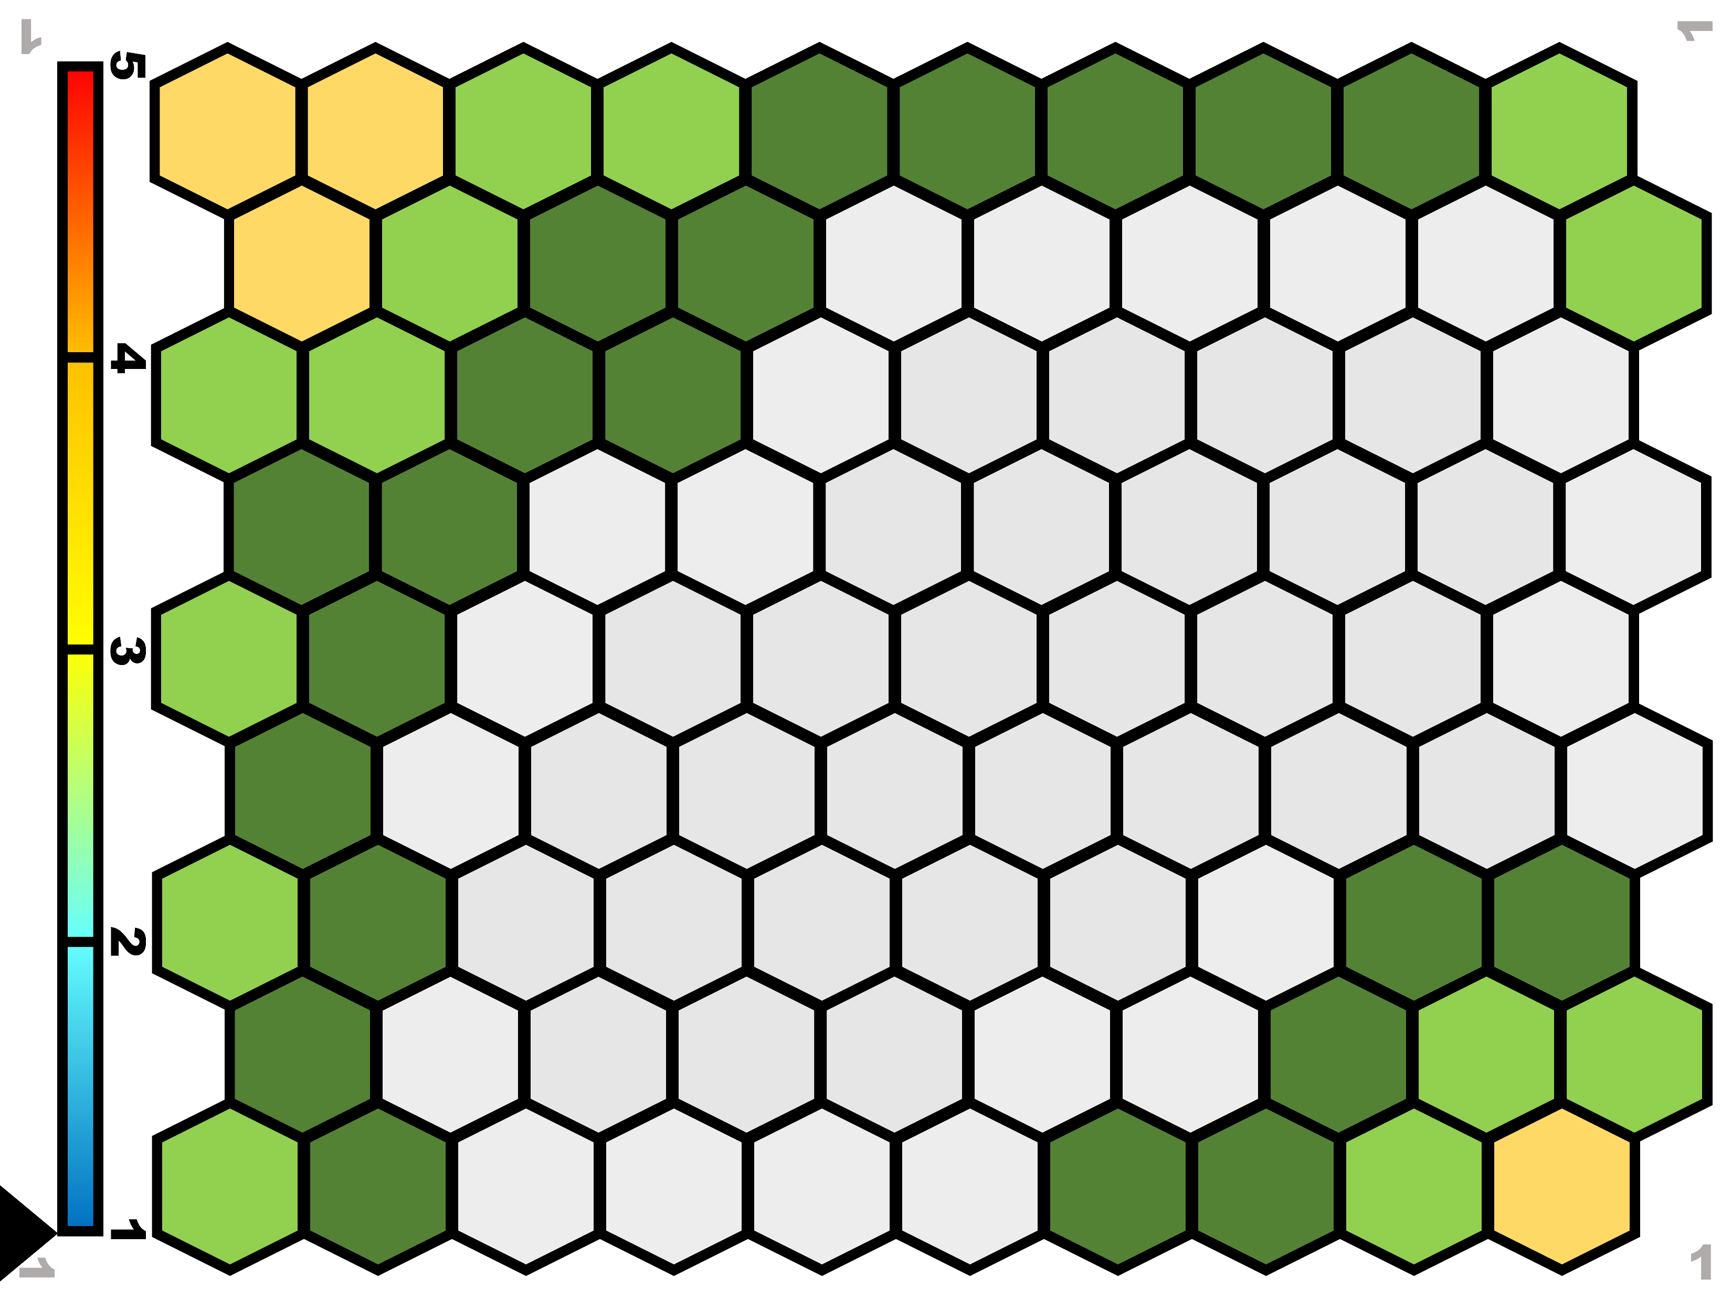
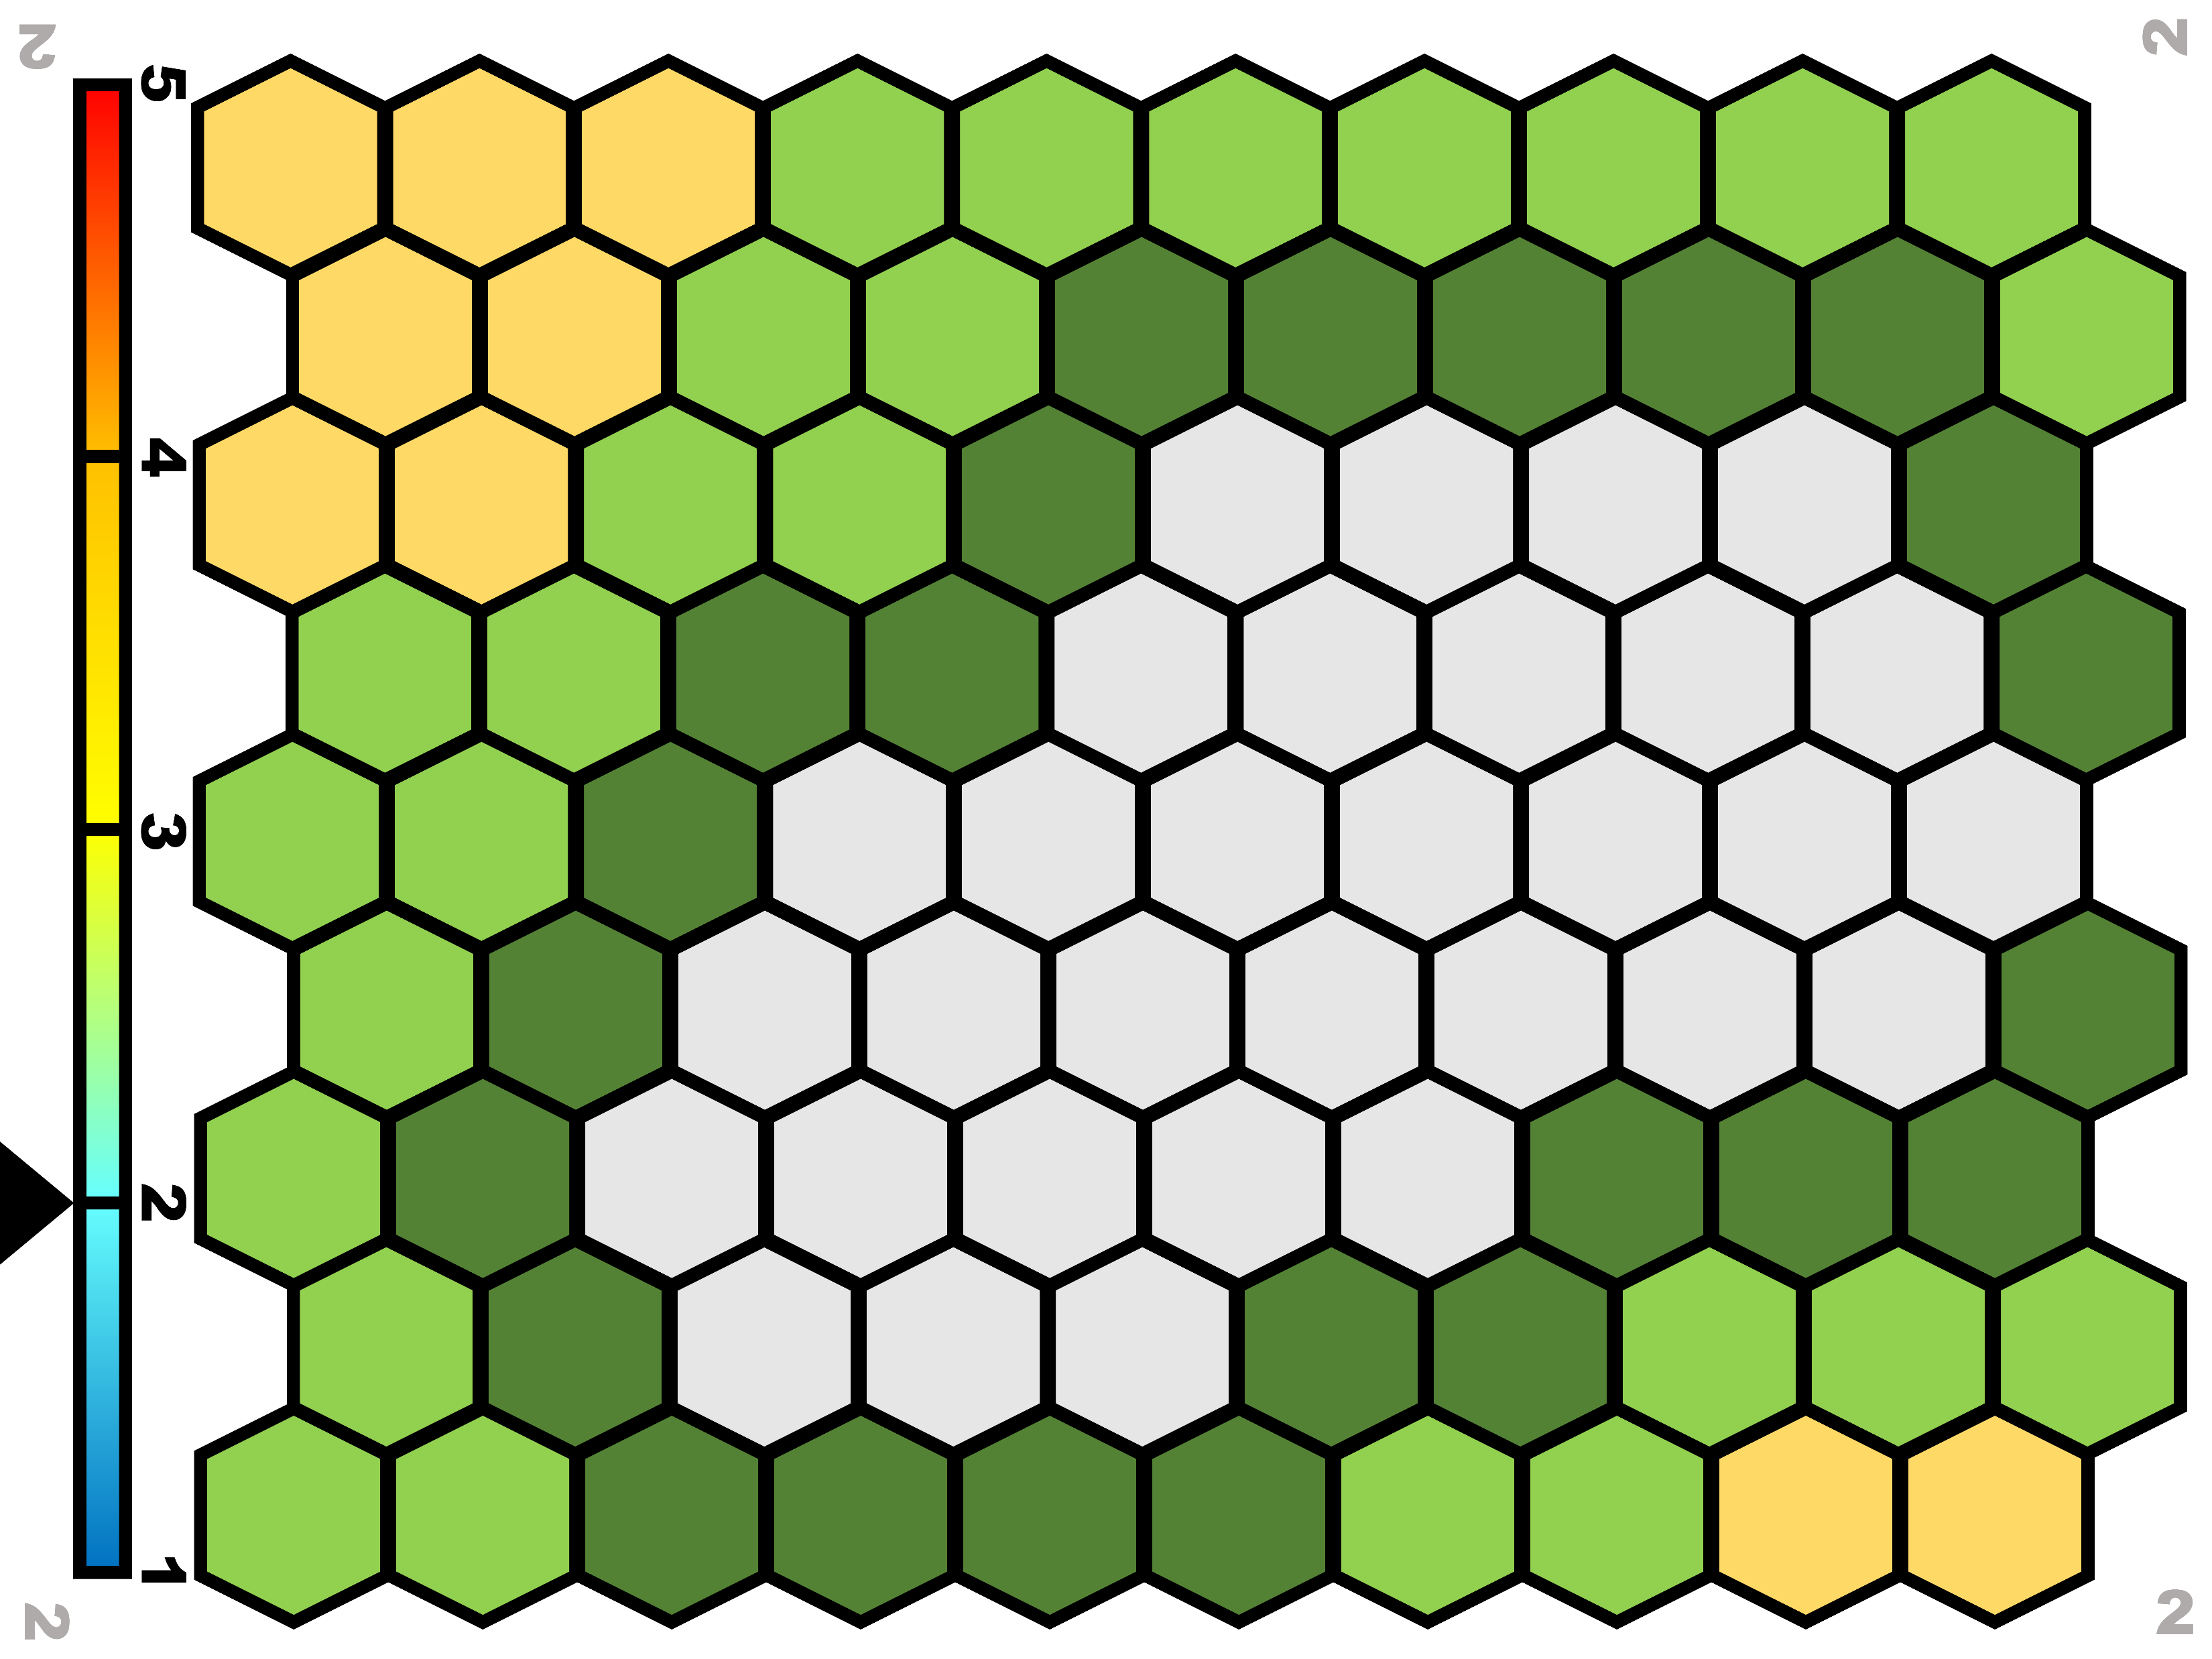
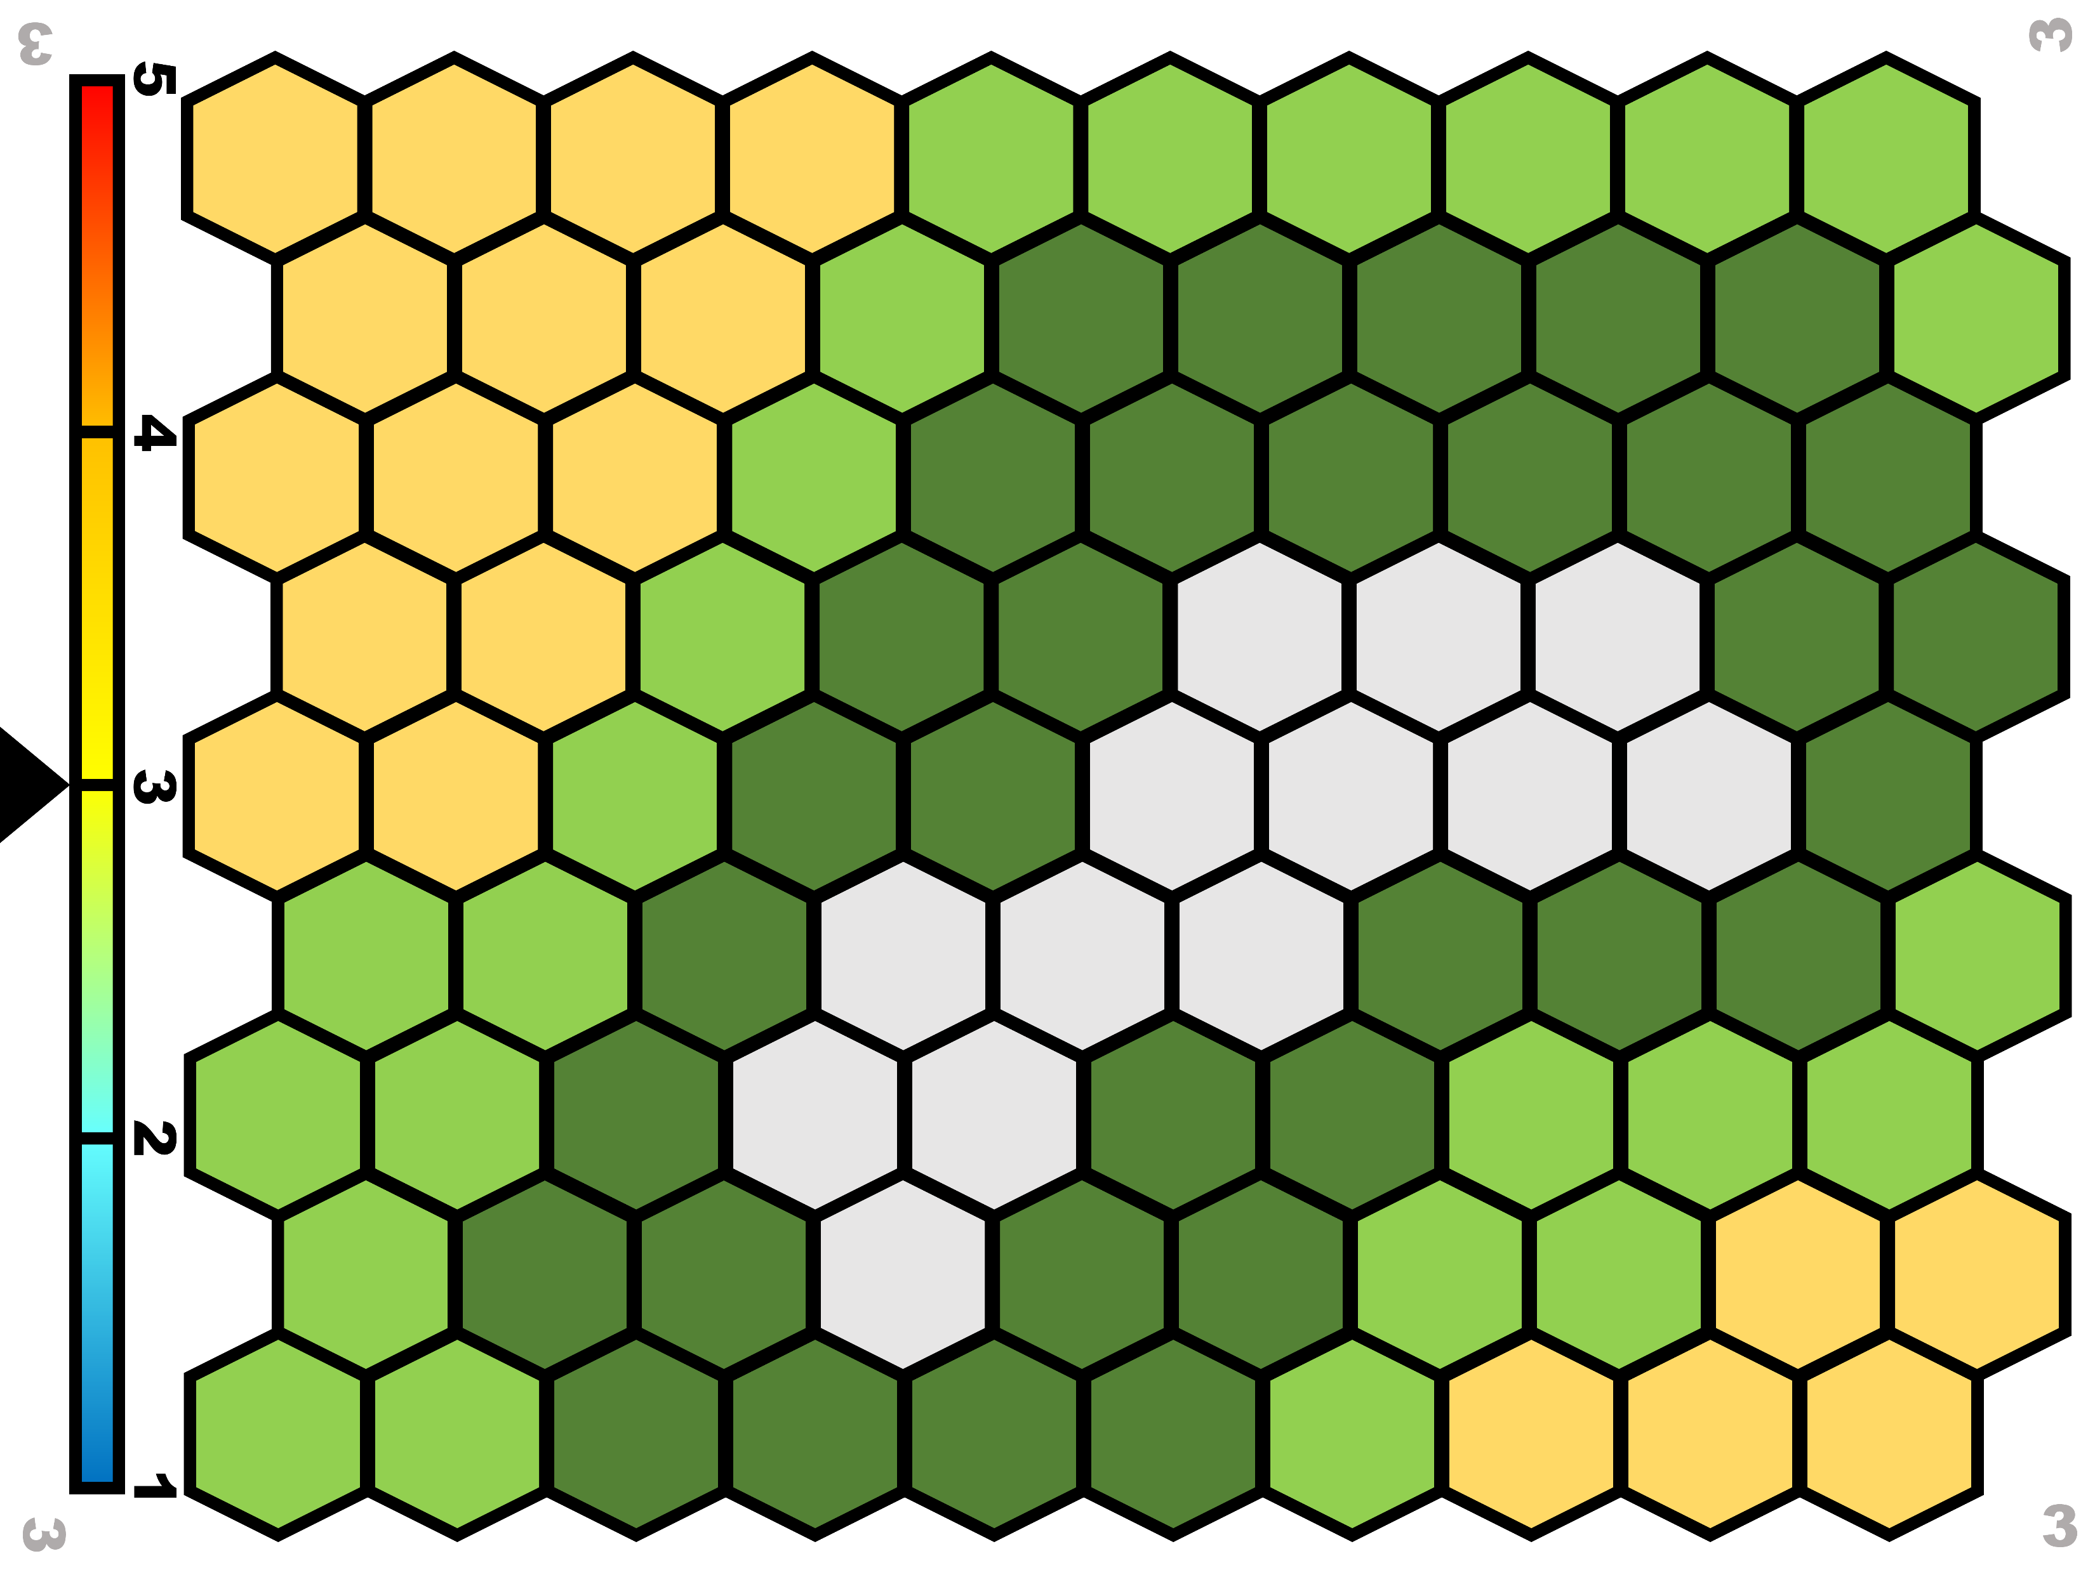
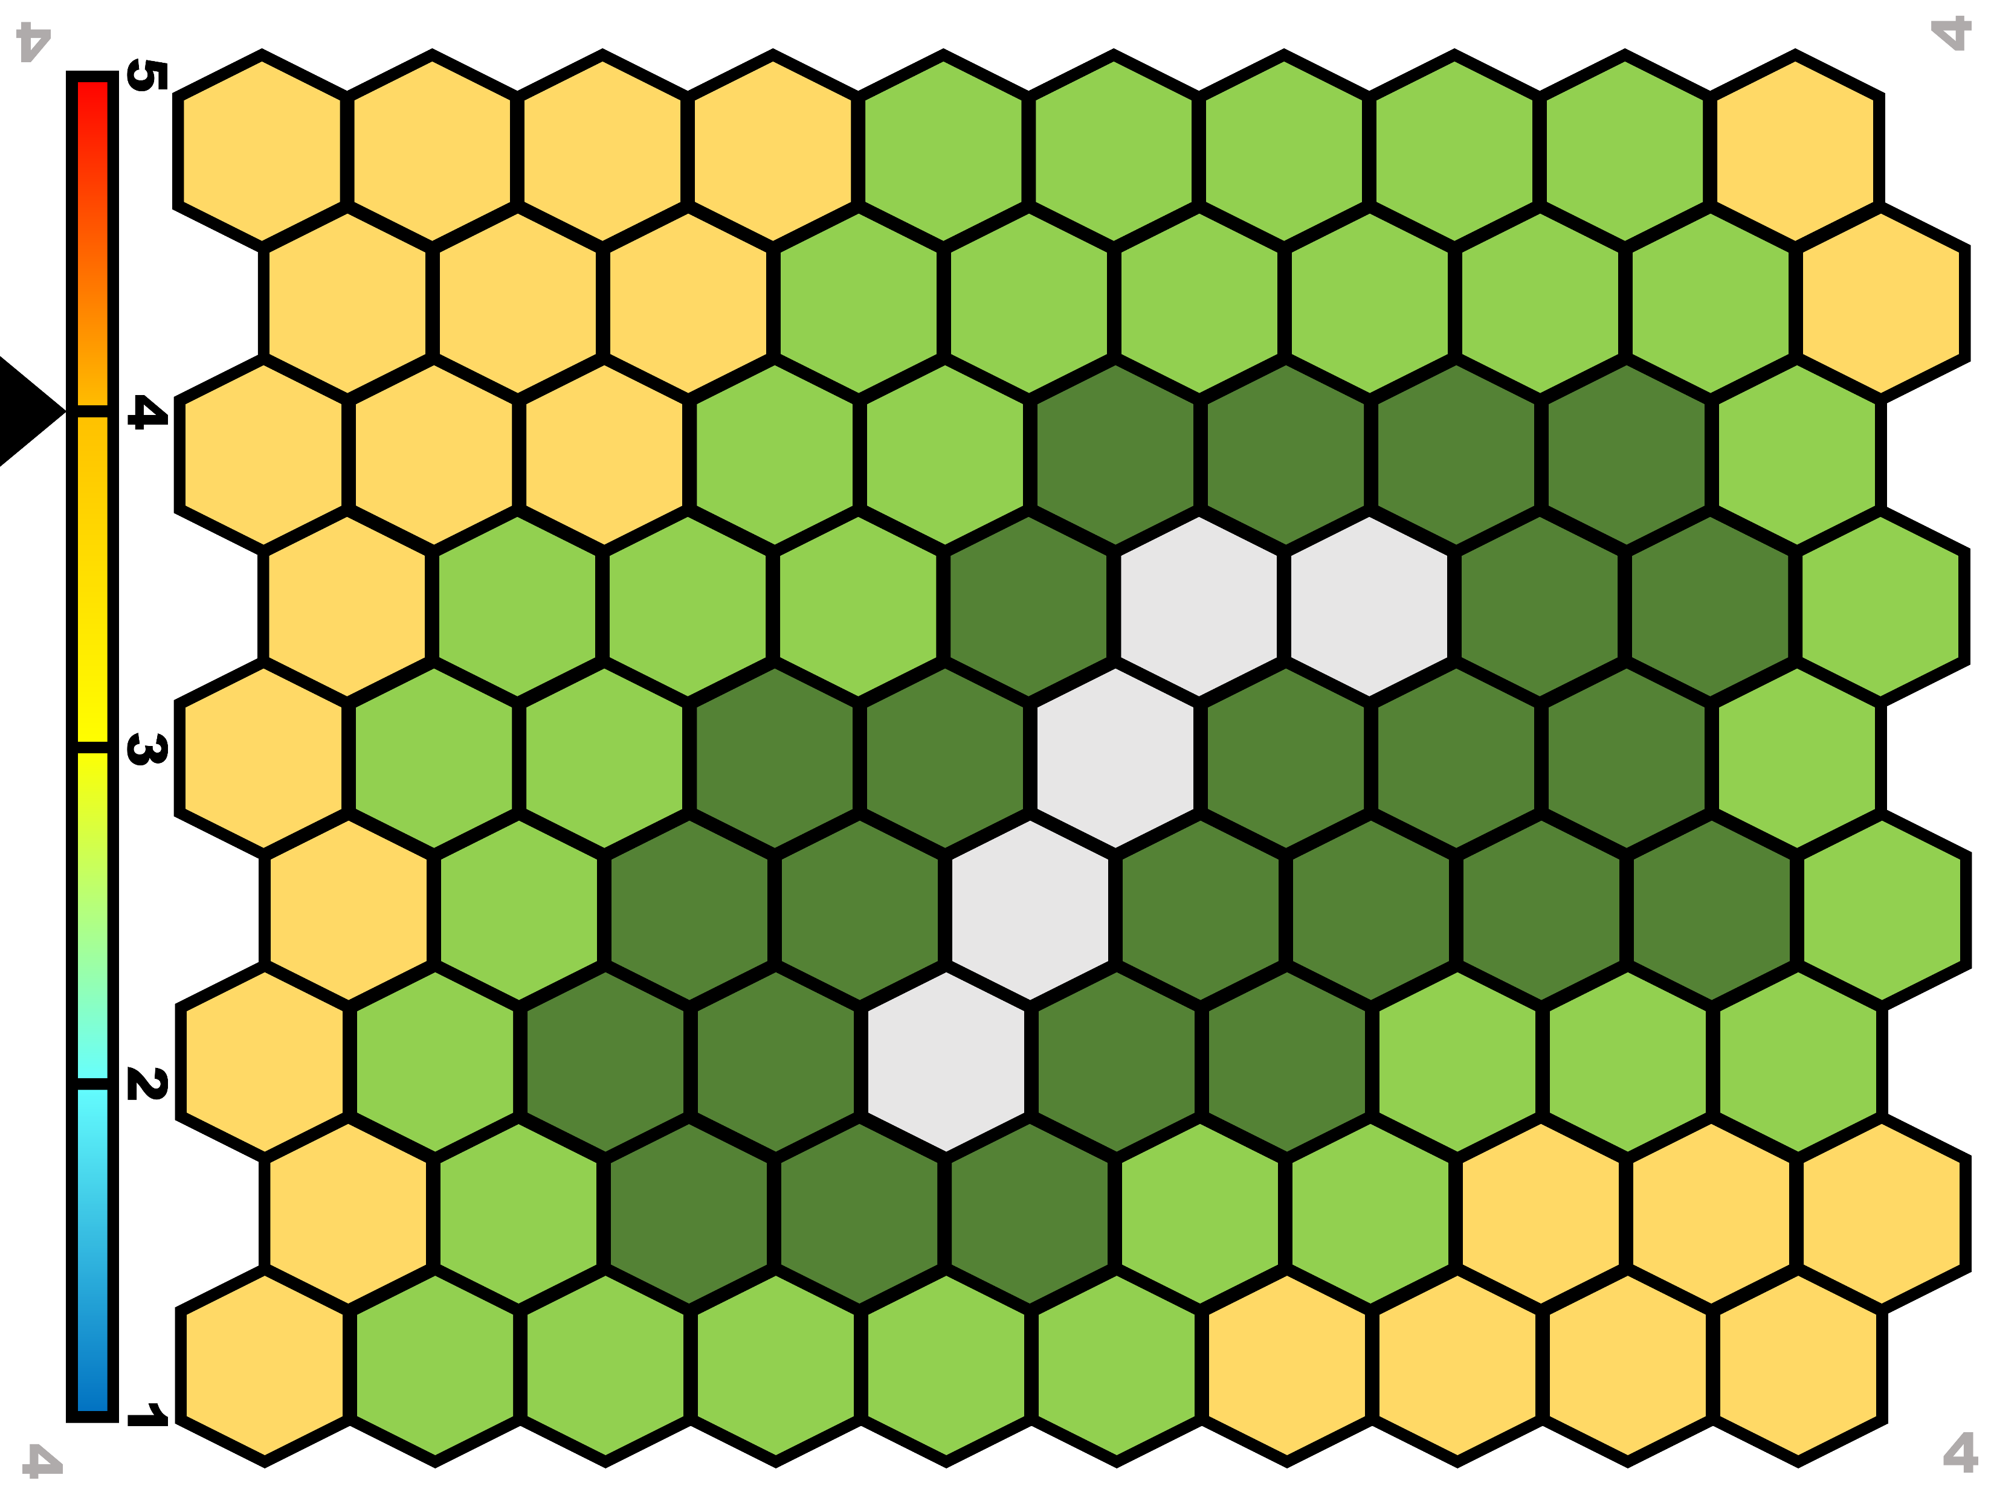
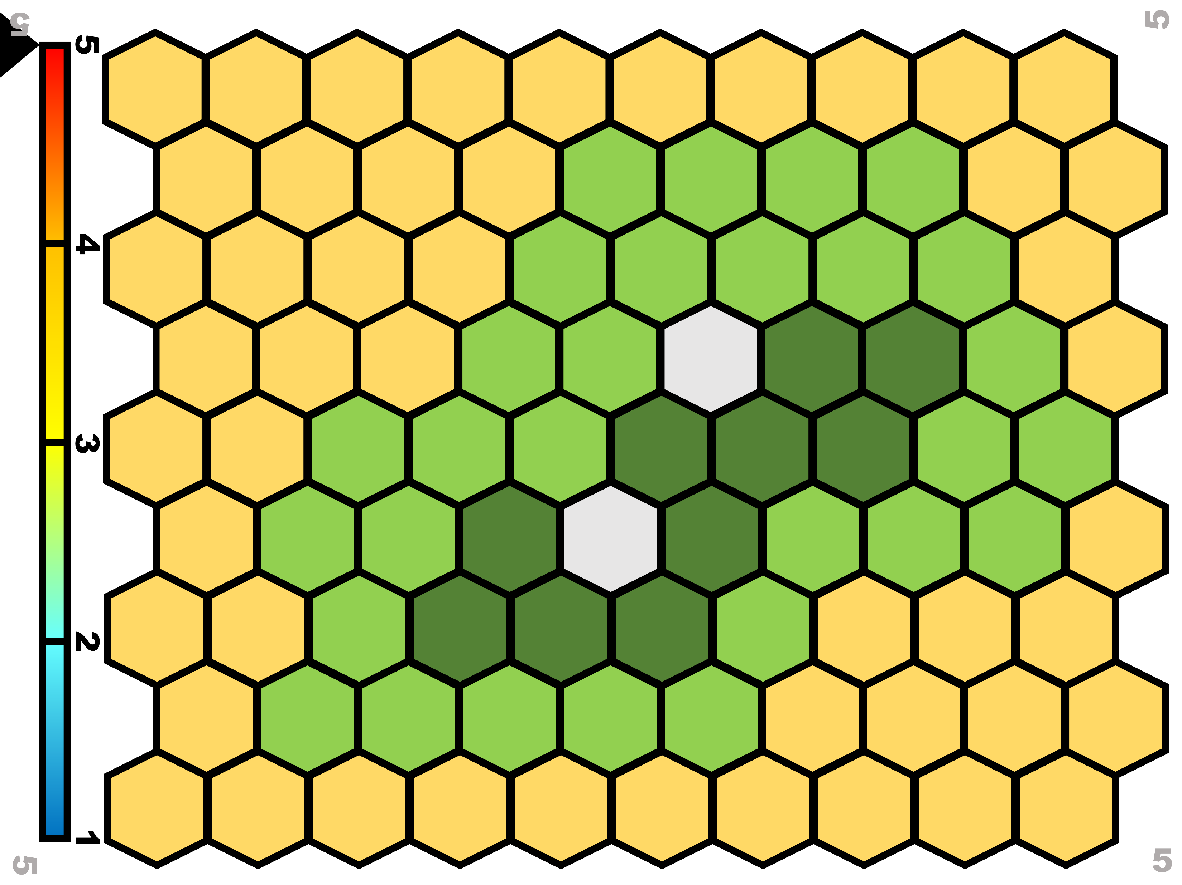
Board: Climate
TTCTTTCATGGGGAAGCAGATTTGGGTACCACCCAAGTATTGACTCACCCATCAACAACCGCTATGTATTTCGTACATTACTGCCAGCCACCATGAATATTGTACGGTACCATAAATACTTGACCACCTGTAGTACATAAAAACCCAATCCACATCAAAACCCCCTCCCCATGCTT3BTM ML19
1
There are 5 levels of temperature (bar on the left) each one associated to a specific combination of the 4 habitats.
Their proportions on the board are based on the overall level of temperature.
Every now and then the climate changes, and the species may find themselves in a new habitat.
2
3
4
5

Slide 6
Climate change and adaptation
TTCTTTCATGGGGAAGCAGATTTGGGTACCACCCAAGTATTGACTCACCCATCAACAACCGCTATGTATTTCGTACATTACTGCCAGCCACCATGAATATTGTACGGTACCATAAATACTTGACCACCTGTAGTACATAAAAACCCAATCCACATCAAAACCCCCTCCCCATGCTT3BTM ML19
Can species live everywhere? No!
Their genome (DNA) contains three genes, coding for three characters: fur colour and type, metabolism, and shape/size of the body. While they live in the savannah each gene is present in a variant that allows them to be adapted to such habitat.
Luckily, during the game each species collect mutations (mutation cards) that, when needed, may allow to change the gene variants in order to adapt to other habitats and survive in them.
In order to survive in any given environment the species must possess at least two of the gene variants associated to the habitat itself.

Slide 7
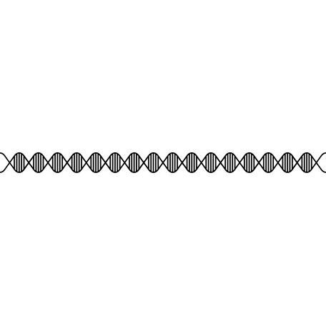




Genome board description
TTCTTTCATGGGGAAGCAGATTTGGGTACCACCCAAGTATTGACTCACCCATCAACAACCGCTATGTATTTCGTACATTACTGCCAGCCACCATGAATATTGTACGGTACCATAAATACTTGACCACCTGTAGTACATAAAAACCCAATCCACATCAAAACCCCCTCCCCATGCTT3BTM ML19
CATGAATATTGTACGGTACCATAAATACTTGACCACCTGTAGTACATAAAAACCCAATCCACATC
3 Genes:
Four variants (=values) for each of them, each allowing adaptation to a specific habitat: from 1 (adapted to savannah) to 4 (adapted to tundra).
3 little stones marks the current level of adaptation.
The value can be changed using the mutation cards (+/-1) associated to each gene. Some cards are neutral, i.e. do not change the value of any gene.
GENOME BOARD
 |  | COLOR |  | BODY |  | METABOLISM
SAV |  | 1 |  | 1 |  | 1
TROP |  | 2 |  | 2 |  | 2
TEMP |  | 3 |  | 3 |  | 3
TUN |  | 4 |  | 4 |  | 4

Slide 8
+1
+1
+1
ACTTGACCACCTGTAG
ACTTGACCACCTGTAG
ACTTGACCACCTGTAG
ACTTGACCACCTGTAG
Fun fact about felines, climate change etc.
MUTATION CARD
BODY
1 UP FOR THE BODY GENE
MUTATION CARD
COLOUR
1 UP FOR THE COLOUR GENE
MUTATION CARD
METABOLISM
1 UP FOR THE METAB. GENE
MUTATION CARD NEUTRAL
NOTHING HAPPENS
-1
-1
-1
ACTTGACCACCTGTAG
ACTTGACCACCTGTAG
ACTTGACCACCTGTAG
ACTTGACCACCTGTAG
MUTATION CARD
BODY
1 DOWN FOR THE BODY GENE
MUTATION CARD
COLOUR
1 DOWN FOR THE COLOUR GENE
MUTATION CARD
METABOLISM
1 DOWN FOR THE METAB. GENE
MUTATION CARD
DELETERIOUS
DISCARD 2 RANDOM CARDS

Slide 9
Preparation
TTCTTTCATGGGGAAGCAGATTTGGGTACCACCCAAGTATTGACTCACCCATCAACAACCGCTATGTATTTCGTACATTACTGCCAGCCACCATGAATATTGTACGGTACCATAAATACTTGACCACCTGTAGTACATAAAAACCCAATCCACATCAAAACCCCCTCCCCATGCTT3BTM ML19
4/5 players, each of them is a species. Each player gets:
A species figurine
A savannah token
A genome containing three genes: size, metabolism and colour.
3 stones to mark the adaptation on the genome board. At the beginning those have to be put on 1, as it is the one associated to savannah.
Two mutation cards.
Put on the table the climate board number 3 and place each species in a yellow cell of choice. Cells cannot be shared between players.
Put the mutation cards in a pile (facing down). Leave some space for a discard pile (facing up)

Slide 10
How to play - 1
TTCTTTCATGGGGAAGCAGATTTGGGTACCACCCAAGTATTGACTCACCCATCAACAACCGCTATGTATTTCGTACATTACTGCCAGCCACCATGAATATTGTACGGTACCATAAATACTTGACCACCTGTAGTACATAAAAACCCAATCCACATCAAAACCCCCTCCCCATGCTT3BTM ML19
The game starts from board 3, with each player in a cell of choice within the Savannah. It is not possible for two or more species to share a cell.
After everybody throwing the dice, starts the player having the highest value, and the game continues clockwise.
At each turn the player picks a mutation card (to be kept covered). If the player has more than 6 cards, one at random must be discarded (ask your neighbour to choose it).
If the player picks a deleterious mutation card he/she must discard two random cards.

Slide 11
How to play - 2
TTCTTTCATGGGGAAGCAGATTTGGGTACCACCCAAGTATTGACTCACCCATCAACAACCGCTATGTATTTCGTACATTACTGCCAGCCACCATGAATATTGTACGGTACCATAAATACTTGACCACCTGTAGTACATAAAAACCCAATCCACATCAAAACCCCCTCCCCATGCTT3BTM ML19
Then the player rolls the dice.
If the value of the dice is between 1 and 3 the species stays where it is, and the turn goes to the next player.
If the value of the dice is between 4 and 6 the species has to move to a neighbouring unoccupied cell of choice.
When the species want to move to a different habitat it needs to adapt, i.e. having the value associated to the new habitat in at least two genes. Such values are changed using mutation cards (specific for each gene) giving +1 or -1 as needed.
Each time a card is used it is put back in the discarded pile. When there are no more cards available from the pile, the discarded pile is shuffled and put back as pile.
Each time a new habitat is occupied, a token is given to the player.

Slide 12
Climate change
TTCTTTCATGGGGAAGCAGATTTGGGTACCACCCAAGTATTGACTCACCCATCAACAACCGCTATGTATTTCGTACATTACTGCCAGCCACCATGAATATTGTACGGTACCATAAATACTTGACCACCTGTAGTACATAAAAACCCAATCCACATCAAAACCCCCTCCCCATGCTT3BTM ML19
At the end of each round the dice must be thrown. If it makes 4, 5, or 6 the climate changes. A second roll of the dice tells if the climate goes one step down (1-3) or up (4-6).
If the climate is already 1 or 5 it can only go respectively up and down. Then the board is changed to the relevant new one.
In the round after a climate change, each player that rolls a 1-3 either is adapted to the cell it is in, or should adapt to it with the DNA cards. If it is not possible to adapt the species get extinct (see next slide).
If the player rolls 4-6 he/she can move two steps, and needs to be adapted or to adapt to the new location to not get extinct.

Slide 13
Extinction
TTCTTTCATGGGGAAGCAGATTTGGGTACCACCCAAGTATTGACTCACCCATCAACAACCGCTATGTATTTCGTACATTACTGCCAGCCACCATGAATATTGTACGGTACCATAAATACTTGACCACCTGTAGTACATAAAAACCCAATCCACATCAAAACCCCCTCCCCATGCTT3BTM ML19
If the species find itself in an habitat to which it is not possible to adapt (e.g.no cards available to allow correct adaptation) it get extinct.
When a species get extinct it gives back all cards and tokens but the yellow one. It then moves to a yellow cell of choice and gets two new cards.

Slide 14
Aim of the game
TTCTTTCATGGGGAAGCAGATTTGGGTACCACCCAAGTATTGACTCACCCATCAACAACCGCTATGTATTTCGTACATTACTGCCAGCCACCATGAATATTGTACGGTACCATAAATACTTGACCACCTGTAGTACATAAAAACCCAATCCACATCAAAACCCCCTCCCCATGCTT3BTM ML19
TROP
SAV
TEMP
TUN
Wins the game the player that collect all 4 habitat tokens

Slide 15
Which species?
TTCTTTCATGGGGAAGCAGATTTGGGTACCACCCAAGTATTGACTCACCCATCAACAACCGCTATGTATTTCGTACATTACTGCCAGCCACCATGAATATTGTACGGTACCATAAATACTTGACCACCTGTAGTACATAAAAACCCAATCCACATCAAAACCCCCTCCCCATGCTT3BTM ML19

Slide 16
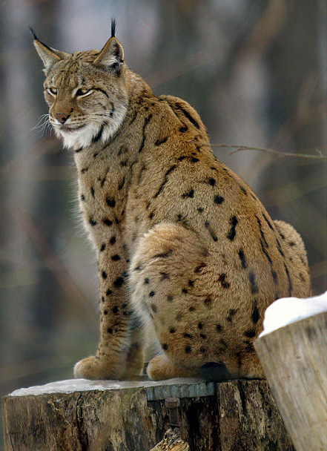
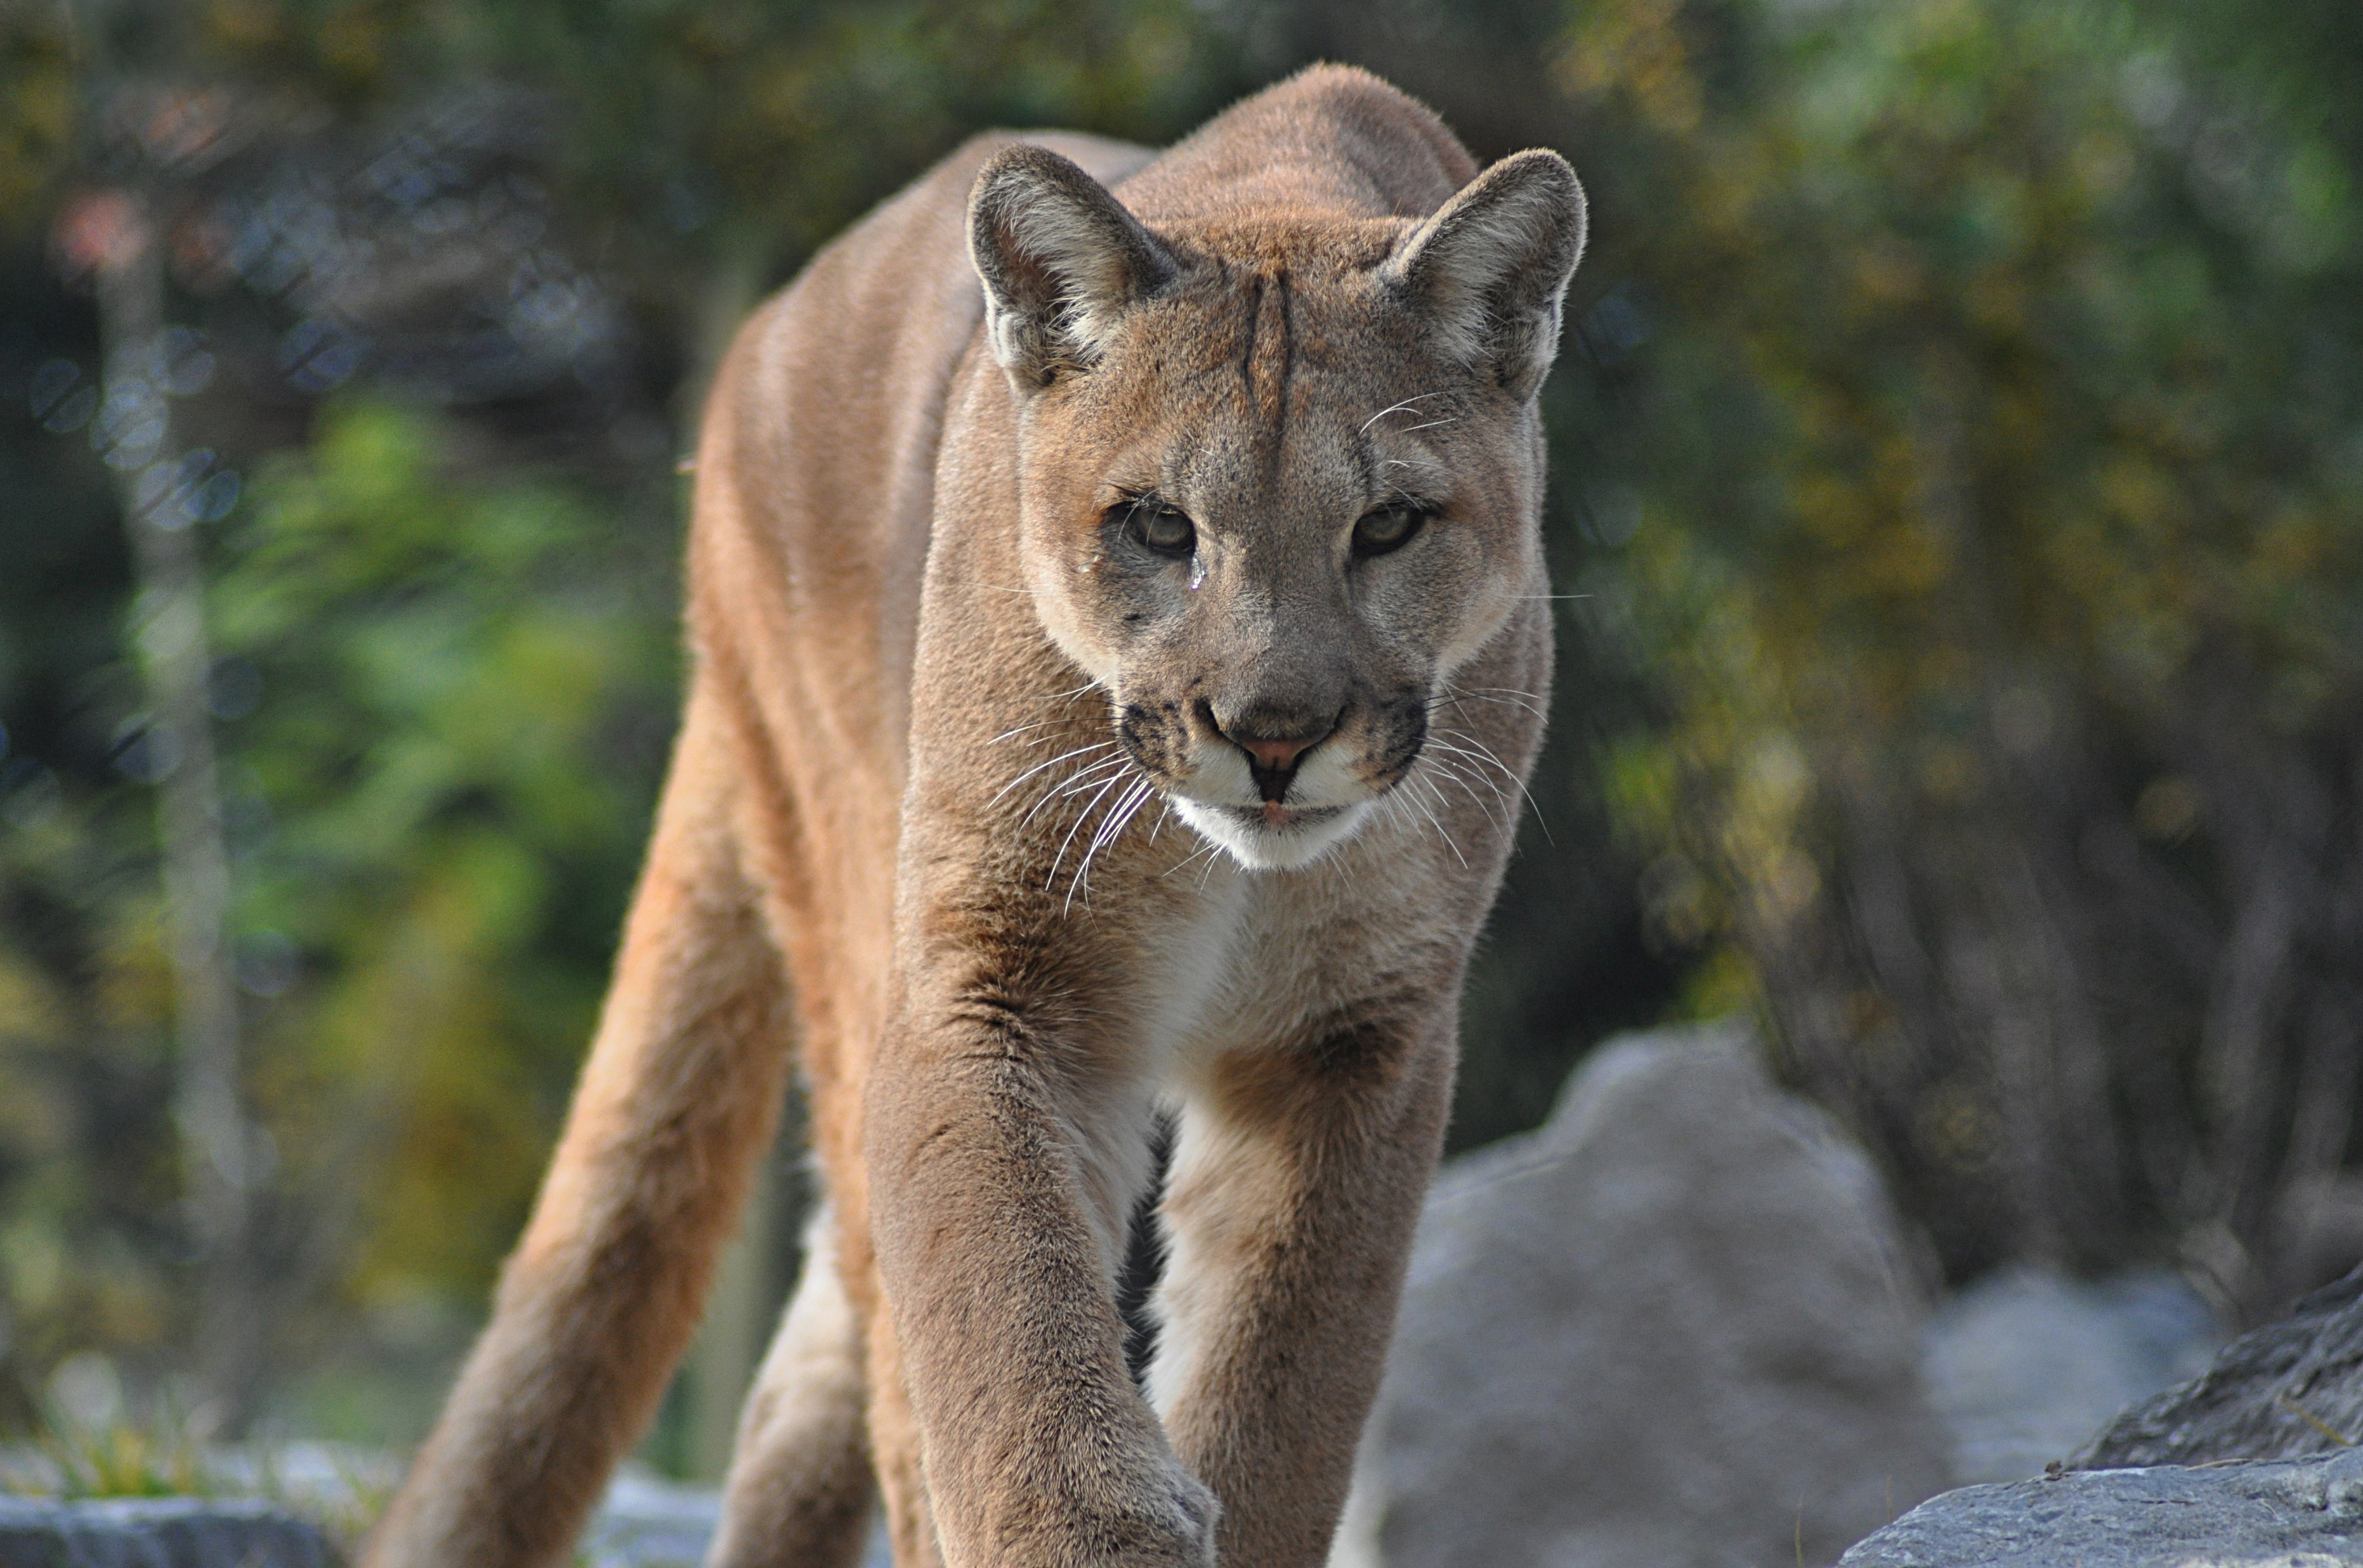
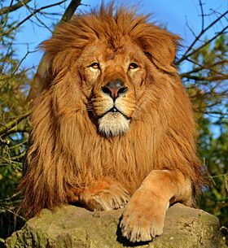
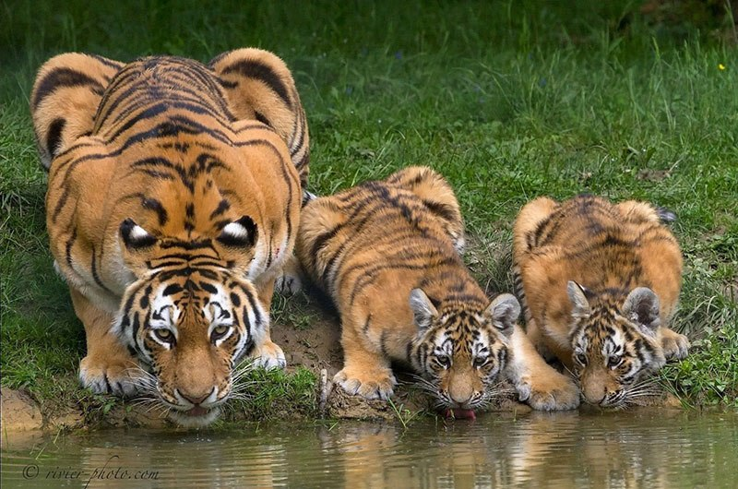
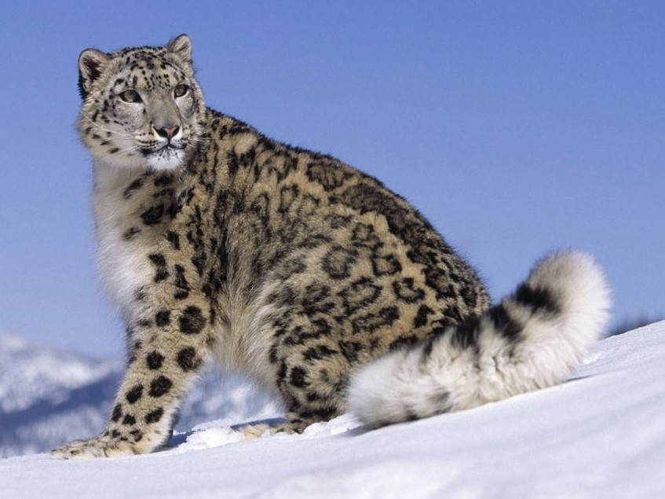
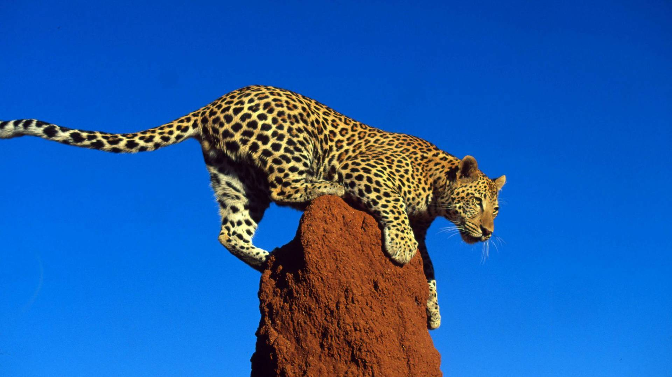
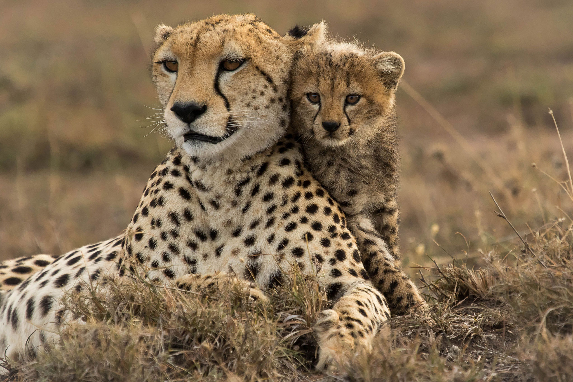
At the end of the game…
TTCTTTCATGGGGAAGCAGATTTGGGTACCACCCAAGTATTGACTCACCCATCAACAACCGCTATGTATTTCGTACATTACTGCCAGCCACCATGAATATTGTACGGTACCATAAATACTTGACCACCTGTAGTACATAAAAACCCAATCCACATCAAAACCCCCTCCCCATGCTT3BTM ML19

